Slide 1
EGYPT
MAJOREL EGYPT | CAWU
LEARNING CENTER
REFUGEE SUPPORT PARTNERSHIP
2020 Q4 – 2021 Q2

Slide 2
EGYPT
> OUR OBJECTIVE
Majorel Egypt aims to maximize the company’s impact on the community through long-term initiatives & meaningful causes that lead to positive change..
> OUR VALUES
HUMANITY FIRST
COMMUNITY
BUILDING
DIVERSITY & INCLUSION
VOLUNTARY
SERVICE

Slide 3
> OUR
CSR PILLARS
DIVERSITY &
INCLUSION
WELLBEING & RESILIENCY
EDUCATION / LEARNING
ENVIROMENTAL
CAUSES &
LOCAL COMMUNITIES
EMPLOYEE
RIGHTS

Slide 4
> ABOUT OUR
CSR PROGRAM & PARTNERSHIP PROGRAM
CONNECTING WITH COMMUNITIES
The “IMPACT CSR” program aims to extend help to our community and create long term; significant, scalable and supportive partnerships with various entities nationwide.
Majorel Egypt signed a 3 year partnership with CAWU ( Center of Arab West Understanding – Learning Center) as part of its “ IMPACT CSR PROGRAM”, an employee-led volunteer effort to support education, learning path and an enhanced school environment for young African refugees ensuring a significant journey – with various initiatives to help uplift some of the most underserved communities & leave an impact in their educational and well-being .

Slide 5
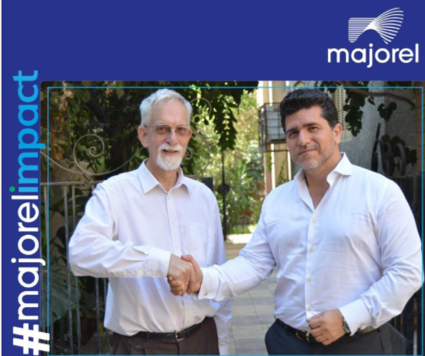
> CENTER FOR ARAB-WEST UNDERSTANDING (CAWU) PARTNERSHIP WITH MAJOREL EGYPT HIGLIGHTS

Slide 6
> MAJOREL EGYPT & CENTER FOR ARAB-WEST UNDERSTANDING (CAWU)- (RELEASE)
MAJOREL EGYPT LAUNCHES “IMPACT” CSR PROGRAM – AND PARTNERS WITH THE CAWU, LEARNING CENTER PROGRAM FOR REFUGEES
Majorel Egypt launched “Majorel Impact Program”, an employee-led volunteer effort to support education, improve health & wellness and more CSR initiatives to help uplift some of the most underserved communities across Egypt.
As its key initiative for 2020-2022 Majorel Egypt has agreed to a long-term partnership with the Center for Arab-West Understanding (CAWU) an NGO in Egypt facilitating intercultural dialogue and providing school/learning facilities for African refugee’s young generations between the age 16-22 who don’t have access to public schools nor International education.
“With now over 7500 professionals Majorel Egypt has grown strengths to strength to be the leading Customer Experience Outsourcing company in the Middle East. But with success and growth also comes responsibility, not only for our clients and employees, but also for our community. I am very proud of the “Impact” CSR program as it transcends and carries our key guiding principles of care for our people/s health, safety and wellbeing into our community and provides hope for a better future for young refugees” states Ricardo Langwieder-Görner. Managing Director of Majorel Egypt.
Cornelis Hulsman, one of the founders of CAWU and principal of the CAWU-Learning Center is extremely pleased with the support of Majorel-Impact. “We want to provide the students with an internationally recognized diploma. This will prepare them for university education and will create leaders in the different refugee communities which in turn will help these communities to address the many challenges they are facing.”
“Majorel Impact”; a program that believes in equal education opportunities, development and accessibility for all children and young adults as a rooted cause of our CSR program. The close co-operation with the CAWU Learning Center will contribute to many collaborations to improve the educational journey for the young refugees. From sponsoring scholarships, providing necessary educational equipment and engaging in off- campus activities. The continued collaboration doesn’t stop at donations, as Majorel staff are passionate and committed to support the CAWU Learning Center across the year with positive contributions to uplift the childrens’ spirit and take part with their diverse tutors on engaging activities that include choirs, sports and other recreation activities all year round.
https://www.linkedin.com/feed/update/urn:li:activity:6742028388988395520

Slide 7
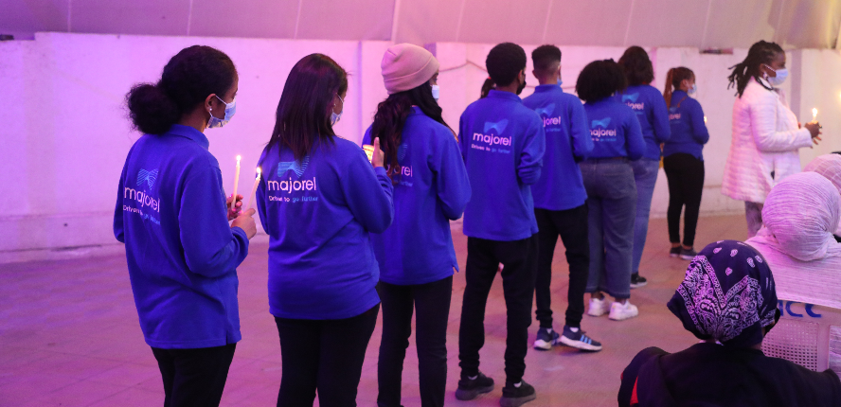
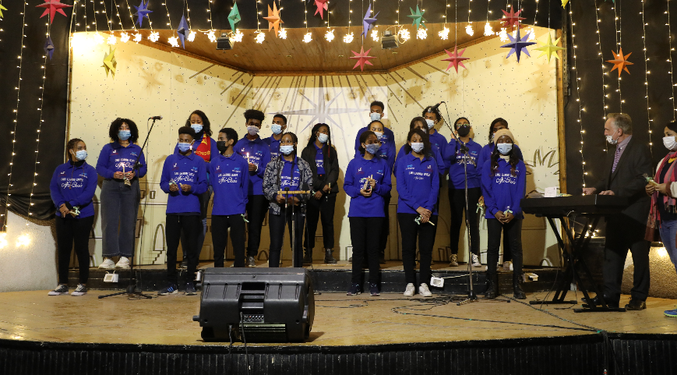
> CHRISTMAS CHOIR
PERFORMANCE DONATION

Slide 8
> MAJOREL EGYPT - EMPOWERS CAWU LEARNING CENTER CHRISTMAS “AFRI-CHOIR” CONCERNT
At Majorel Egypt, “Impact” CSR program believes that, every day should be the most wonderful time of the year for our children.
The festive spirit of Christmas kept us connected (while keeping a safe distance) , as the CAWU - Learning Center Refugee Choir held a dazzling performance by the students “Afri-Choir”. The evening was lit by candlelight, as the choir performed “Silent Night, You Raise Me Up, Hallelujah and I will follow Him.”
The music of the Afri-Choir that spread happiness to all attendees was sponsored by Majorel Egypt by supporting CAWU – Learning Center with music instruments, Choir uniform & flyers along with donations from our people to make the evening entirely magical.
Majorel CSR program “Impact” is committed to a spiritual & impactful transformative partnership with CAWU Learning Center for Refugees and more meaningful initiatives in 2021.
MAJOREL EGYPT EMPOWERS “AFRI-CHOIR” CHRISTMAS PERFORMANCE BY CAWU, LEARNING CENTER PROGRAM FOR REFUGEES
CLICK FOR–
CHOIR VIDEO
https://www.linkedin.com/feed/update/urn:li:activity:6750054182151077888

Slide 9
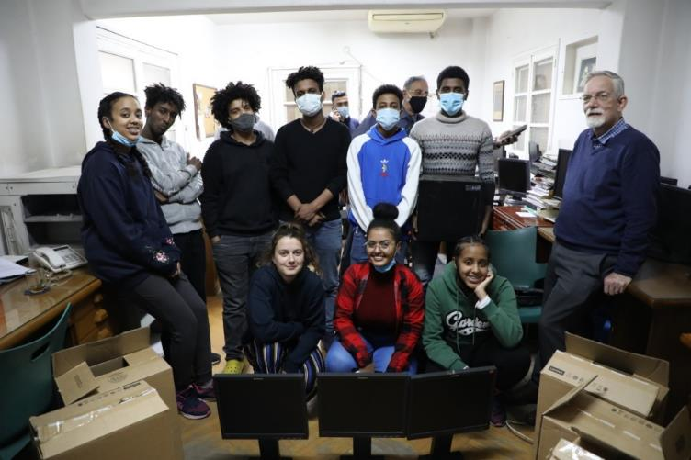
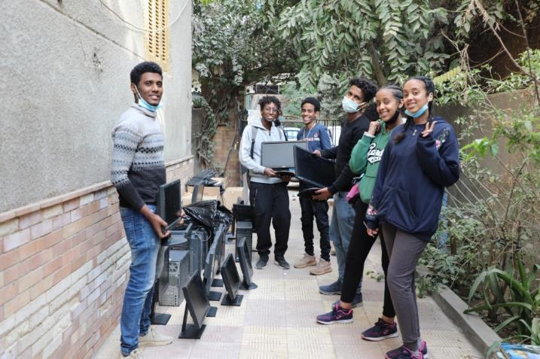
EDUCATION CONTINUITY
SUPPORT :
PCs/ CONNECTIVITY & CLASSROOM
FACILITIES
CHILDREN’S DELIGHT WITH PCS DELIVERED TO
CAWU LEARNING CENTER

Slide 10
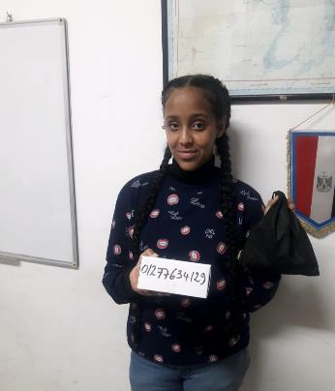
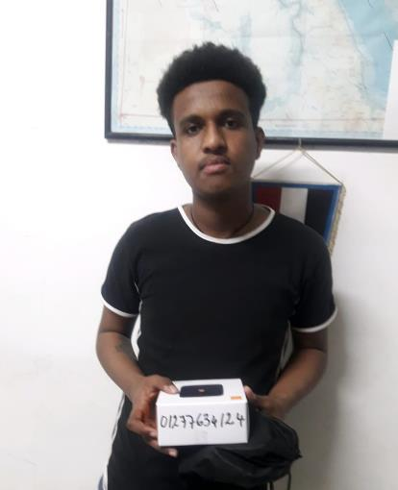
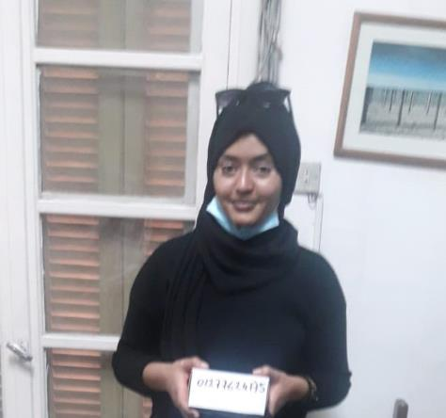
EDUCATION CONTINUITY
SUPPORT :
PCs/ CONNECTIVITY & CLASSROOM
FACILITIES
INTERNET CONNECTIVITY SUPPORTED BY MAJOREL EGYPT FOR CAWU LEARNING CENTER

Slide 11
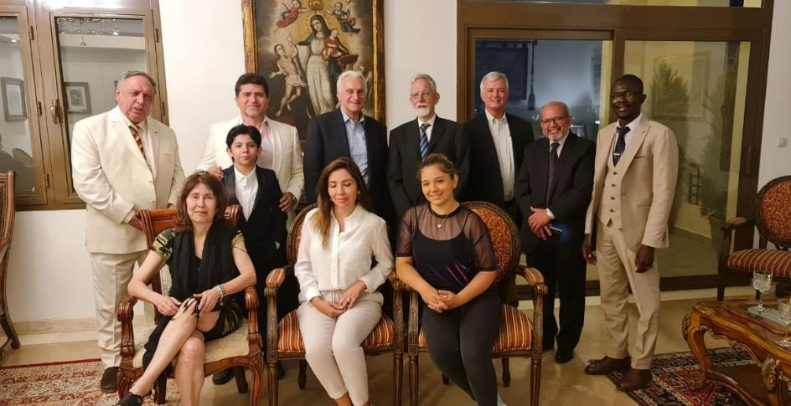
EDUCATION CONTINUITY
SUPPORT :
FUNDRAISING DINNER
THE AMERICAN UNIVERSITY IN CAIRO, & MAJOREL EGYPT TO SUPPORT IN REFURBISHING CLASSROOM FACILITIES FOR CAWU LEARNING CENTER

Slide 12
> MAJOREL EGYPT - CONTRIBUTES TO FULL SCHOOL/SESSIONS CONNECTIVITY FACILITIES & CLASSROOM FACILITIES FOR CAWU LEARNING CENTER
Majorel Egypt , the leading BPO/CX company, under its CSR initiative, has announced to launching a dedicated program in 2021 to support connectivity & technology support for CAWU - Learning Center Refugee during COVID to enable educational activities & sessions to move forward during the toughest times.
The CSR team – along with Majorel Egypt’s IT team , identified the critical problems including providing PCs & connectivity devices for the children – to ensure that the education engagement & continuity of the learning set-up across all online sessions is significantly subsidized.
Majorel Egypt also organized a Charity dinner to support raising funds for enhanced classroom & learning facilities for CAWU Learning Center for Refugees. It was incredible to witness a prominent crowd, coming together to support a good cause. The gathering was a chance for all supporters to converse with the Majorel Egypt’s CEO, Ricardo Langwieder and other leaders gathered to discuss developing the capabilities needed for a successful learning environment.
Picture - From left to right standing: Peter Mathias, CEO Achieve Education International Consultants For Tomorrow, Ricardo Langwieder, CEO Majorel Egypt , Francis Ricciardoni, H.E. Francis J. Ricciardoni, president of the American University in Cairo (AUC) and former US Ambassador to Egypt. Drs.Cornelis Hulsman, Principal Centre for Arab-West Report Learning Centre for refugees, Prof. Dr. Thomas DeVere Wolsey, Department of International and Comparative Education AUC, Seleem Wassef, former Director General Ministry of Education, Fr. Claude Yadjimadji, St. Joseph Learning Centre for Eritrean refugees. Standing before Ricardo Langwieder, Ricardo Langwieder jr. Sitting from left to right: Dr. Brooke Comer, instructor at the Department of Rhetoric and Composition. She is incorporating Community Based Learning in her courses at AUC: Carolina Langwieder, Paula Langwieder, Volunteer instructor ICT at the CAWU Learning Centre in October-December 2020.

Slide 13
THANK YOU

